Slide 1
Object Detection

Slide 2
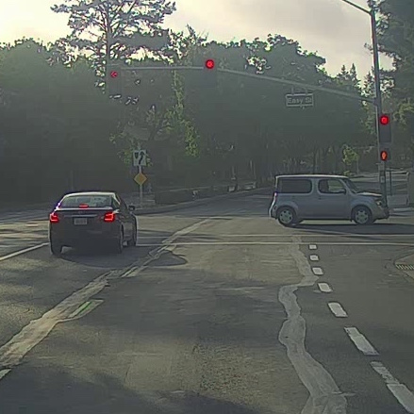
What are localization and detection?
Image classification
Classification with
localization
Detection

Slide 3
Note:
After this slide, directly sliding window should be taught as it is detection via classification, then, classification with localization as it uses regression approach for bounding box detection. Then, we should discuss detection via regression, i.e. YOLO.

Slide 4
Car detection example
Training set:
x
y
1
1
1
0
0

Slide 5
Sliding windows detection

Slide 6
Sliding windows detection
Sliding window approach for detection is computationally intensive.

Slide 7
Sliding windows detection
As discussed, sliding window approach for detection is computationally intensive.
Also, we discussed that CNN can work with variable size images just know, and before, when we discussed about transfer learning.

Slide 8
Object Detection
Convolutional implementation of sliding windows

Slide 9
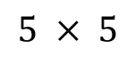
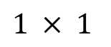
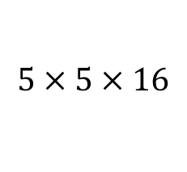
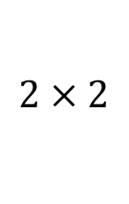
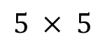
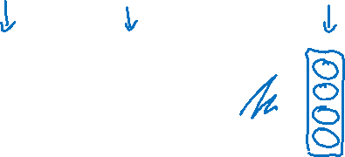
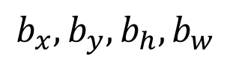
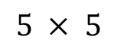
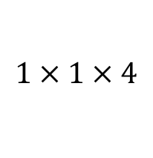
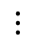
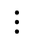
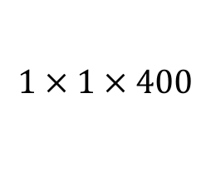
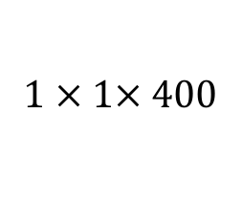
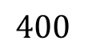
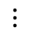
Turning FC layer into convolutional layers
MAX POOL
FC
FC
$$5 × 5$$
$$2 × 2$$
$$⋮$$
$$⋮$$
y
softmax (4)
$$14 × 14 × 3$$
$$10 × 10 × 16$$
$$5 × 5 × 16$$
$$400$$
$$400$$
MAX POOL
FC
FC
$$5 × 5$$
$$2 × 2$$
$$5 × 5$$
$$1 × 1$$
$$14 × 14 × 3$$
$$10 × 10 × 16$$
$$5 × 5 × 16$$
$$1 × 1× 400$$
$$1 × 1 × 400$$
$$1 × 1 × 4$$

Slide 10
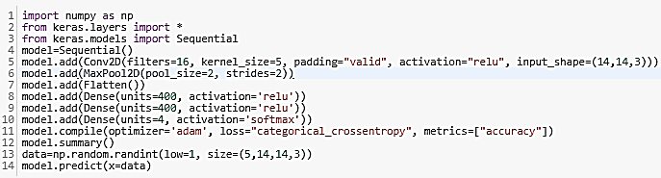
Turning FC layer into convolutional layers

Slide 11
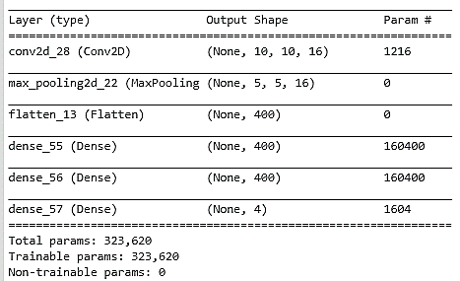
Turning FC layer into convolutional layers
Now, what if I change the size of x=data to 5 x 16 x 16 x 3 ?

Slide 12
Turning FC layer into convolutional layers
Now, what if I change the size of data to 5 x 16 x 16 x 3 ? → Error

Slide 13
Turning FC layer into convolutional layers
In previous slide, we can set input_shape=(None, None, 3) and can use the network to predict on images of different spatial resolution but the problem would be Flatten (or Dense) layer. Flatten requires full specification. We can connect output of MaxPool2D to Dense directly but it will result in input_shape of Dense to be (None, 5, 5, 16). Dense will consider it like each input is 5 x 5 and dimensionality of each of these 5 x 5 is 16. Output shape of Dense would be (None, 5, 5, 400). Number of parameters in Dense would be 16 x 400 + 400 = 6800.

Slide 14
Turning FC layer into convolutional layers
Please note that the size of the spatial dimension of feature maps is not hyper-parameter but number of neurons in Dense (and therefore flatten) is a hyper-parameter.

Slide 15
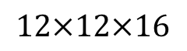
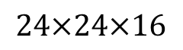
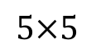
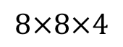
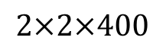
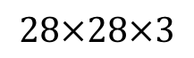
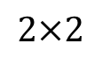
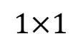
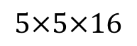
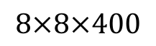

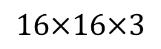
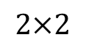
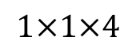
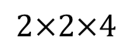
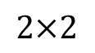
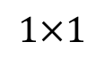
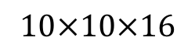
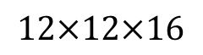
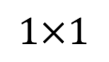
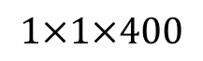
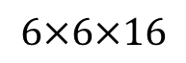
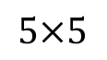
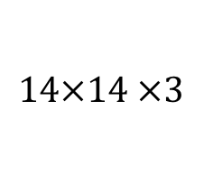
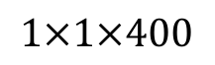
Convolution implementation of sliding windows
MAX POOL
FC
FC
FC
$$5×5$$
$$2×2$$
$$5×5$$
$$1×1$$
$$1×1$$
$$14×14 ×3$$
$$10×10×16$$
$$5×5×16$$
$$1×1×400$$
$$1×1×400$$
$$1×1×4$$
MAX POOL
FC
FC
FC
$$5×5$$
$$2×2$$
$$5×5$$
$$1×1$$
$$1×1$$
$$16×16×3$$
$$12×12×16$$
$$6×6×16$$
$$2×2×400$$
$$2×2×400$$
$$2×2×4$$
MAX POOL
$$5×5$$
$$2×2$$
$$5×5$$
$$1×1$$
$$1×1$$
$$28×28×3$$
$$24×24×16$$
$$12×12×16$$
$$8×8×400$$
$$8×8×400$$
$$8×8×4$$
[Sermanet et al., 2014, OverFeat: Integrated recognition, localization and detection using convolutional networks]

Slide 16
Convolution implementation of sliding windows
Size of output volume = { [Size of input volume (16 x 16 or 28 x 28) – Size of Original Patch (14 x 14)]/2 + 1}

Slide 17
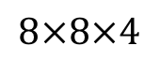
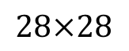
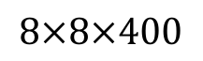
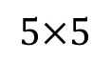
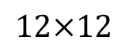
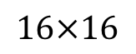
Convolution implementation of sliding windows
MAX POOL
$$5×5$$
$$2×2$$
$$5×5$$
$$1×1$$
$$1×1$$
$$28×28$$
$$16×16$$
$$12×12$$
$$8×8×400$$
$$8×8×400$$
$$8×8×4$$

Slide 18
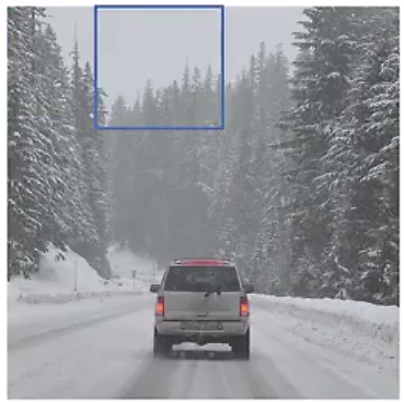
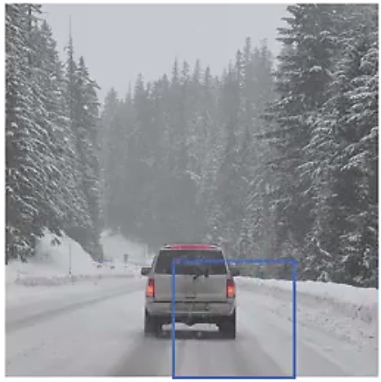

Output Accurate Bounding Boxes

Slide 19
Output Accurate Bounding Boxes
It is further to be noticed that we are giving a patch (14 x 14)/set of patches (16 x 16 or 28 x 28) as input and we are classifying the patch to decide whether it has any object of interest. If yes, the (patch boundaries)/patch are/is accepted as the bounding box. We can infact detecting bounding box problem as the regression problem.

Slide 20
Classification with localization (Regression Approach for Bounding Box)
$$⋯$$
$$⋮$$
1 - pedestrian
2 - car
3 - motorcycle
4 - background

Slide 21

Defining the target label y
1 - pedestrian
Need to output $b_{x},b_{y},b_{h}, b_{w},$class label (1-4)
2 - car
3 - motorcycle
4 - background

Slide 22
Object Detection
Landmark detection

Slide 23
Landmark detection
ConvNet
$$b_{x},b_{y},b_{h}, b_{w}$$

Slide 24

YOLO Algorithm

Slide 25

YOLO Algorithm
Specify the Bounding Boxes

Slide 26
Object Detection
Intersection over union

Slide 27
Evaluating object localization
“Correct” if IoU $≥$ 0.5
More generally, IoU is a measure of the overlap between two bounding boxes.

Slide 28
Object Detection
Non-max suppression

Slide 29
Non-max suppression example

Slide 30
Non-max suppression example
0.6
0.8
0.9
0.3
0.5

Slide 31
Non-max suppression example
0.6
0.8
0.9
0.7
0.7

Slide 32
Non-max suppression algorithm
$$\left[\begin{aligned}p_{c} \\ b_{x} \\ b_{y} \\ b_{h} \\ b_{w}\end{aligned}\right]$$
Each output prediction is:
Discard all boxes with $p_{c}≤0.6$
While there are any remaining boxes:
Pick the box with the largest $p_{c}$
Output that as a prediction.
19$×19$
Discard any remaining box with
IoU $≥0.5$with the box output
in the previous step

Slide 33
Object Detection
Anchor boxes

Slide 34


Overlapping objects:
Anchor box 1:
Anchor box 2:
$$\left[\begin{aligned}p_{c} \\ b_{x} \\ b_{y} \\ b_{h} \\ b_{w} \\ c_{1} \\ c_{2} \\ c_{3}\end{aligned}\right]$$
y =
[Redmon et al., 2015, You Only Look Once: Unified real-time object detection]

Slide 35
Anchor box algorithm
Previously:
With two anchor boxes:
Each object in training image is assigned to grid cell that contains that object’s midpoint.
Each object in training image is assigned to grid cell that contains object’s midpoint and anchor box for the grid cell with highest IoU.

Slide 36
Anchor box example
y = $\left[\begin{aligned}p_{c} \\ b_{x} \\ b_{y} \\ b_{h} \\ b_{w} \\ c_{1} \\ c_{2} \\ c_{3} \\ p_{c} \\ b_{x} \\ b_{y} \\ b_{h} \\ b_{w} \\ c_{1} \\ c_{2} \\ c_{3}\end{aligned}\right]$
Anchor box 1:
Anchor box 2:

Slide 37
Object Detection
Putting it together:
YOLO algorithm

Slide 38
Training
1 - pedestrian
2 - car
$\left[\begin{aligned}p_{c} \\ b_{x} \\ b_{y} \\ b_{h} \\ b_{w} \\ c_{1} \\ c_{2} \\ c_{3} \\ p_{c} \\ b_{x} \\ b_{y} \\ b_{h} \\ b_{w} \\ c_{1} \\ c_{2} \\ c_{3}\end{aligned}\right]$
$$\left[\begin{aligned}0 \\ ? \\ ? \\ ? \\ ? \\ ? \\ ? \\ ? \\ 0 \\ ? \\ ? \\ ? \\ ? \\ ? \\ ? \\ ?\end{aligned}\right]$$
$$\left[\begin{aligned}0 \\ ? \\ ? \\ ? \\ ? \\ ? \\ ? \\ ? \\ 1 \\ b_{x} \\ b_{y} \\ b_{h} \\ b_{w} \\ 0 \\ 1 \\ 0\end{aligned}\right]$$
3 - motorcycle
y
=
y is $3×3×2×8$
[Redmon et al., 2015, You Only Look Once: Unified real-time object detection]

Slide 39
Making predictions
$\left[\begin{aligned}p_{c} \\ b_{x} \\ b_{y} \\ b_{h} \\ b_{w} \\ c_{1} \\ c_{2} \\ c_{3} \\ p_{c} \\ b_{x} \\ b_{y} \\ b_{h} \\ b_{w} \\ c_{1} \\ c_{2} \\ c_{3}\end{aligned}\right]$
$$⋯$$
$y$ =
$$3×3×2×8$$

Slide 40

Outputting the non-max supressed outputs
For each grid cell, get 2 predicted bounding boxes.
Get rid of low probability predictions.
For each class (pedestrian, car, motorcycle) use non-max suppression to generate final predictions.

Slide 41
Object Detection
Region proposals
(Optional)

Slide 42

Region proposal: R-CNN
[Girshik et. al, 2013, Rich feature hierarchies for accurate object detection and semantic segmentation]

Slide 43
Faster algorithms
R-CNN:
Propose regions. Classify proposed regions one at a time. Output label + bounding box.
Fast R-CNN:
Propose regions. Use convolution implementation of sliding windows to classify all the proposed regions.
Faster R-CNN:
Use convolutional network to propose regions.
[Girshik et. al, 2013. Rich feature hierarchies for accurate object detection and semantic segmentation]
[Girshik, 2015. Fast R-CNN]
[Ren et. al, 2016. Faster R-CNN: Towards real-time object detection with region proposal networks]

Slide 44
Mean Average Precision (mAP) [1]
True Positive (TP): A correct detection. Detection with IOU ≥ threshold

Slide 45
Mean Average Precision (mAP) [1]
True Positive (TP): A correct detection. Detection with IOU ≥ threshold
False Positive (FP): A wrong detection. Detection with IOU < threshold

Slide 46
Mean Average Precision (mAP) [1]
True Positive (TP): A correct detection. Detection with IOU ≥ threshold
False Positive (FP): A wrong detection. Detection with IOU < threshold
False Negative (FN): A ground truth not detected

Slide 47
Mean Average Precision (mAP) [1]
True Positive (TP): A correct detection. Detection with IOU ≥ threshold
False Positive (FP): A wrong detection. Detection with IOU < threshold
False Negative (FN): A ground truth not detected
True Negative (TN): Does not apply. It would represent a corrected misdetection. In the object detection task there are many possible bounding boxes that should not be detected within an image. Thus, TN would be all possible bounding boxes that were correctly not detected (so many possible boxes within an image). That's why it is not used by the metrics.

Slide 48
Mean Average Precision (mAP) [1]
Let us say that the model has detected some bounding box and labelled that as “person”. We need to compare the detected bounding box with all ground truth bounding boxes of person. If the IoU between the detected bounding box and any ground truth bounding box of person is >= threshold, we say that the detection is TP

Slide 49
Mean Average Precision (mAP) [1]
Let us say that the model has detected some bounding box and labelled that as “person”. We need to compare the detected bounding box with all ground truth bounding boxes of person. If the IoU between the detected bounding box and any ground truth bounding box of person is >= threshold, we say that the detection is TP
Also, please remember, we calculate this (TP, FP and FN as well as Precision and Recall) for each of the classes separately.

Slide 50
Mean Average Precision (mAP) [1]
Let us say that the model has detected some bounding box and labelled that as “person”. We need to compare the detected bounding box with all ground truth bounding boxes of person. If the IoU between the detected bounding box and any ground truth bounding box of person is >= threshold, we say that the detection is TP
Also, please remember, we calculate this (TP, FP and FN as well as Precision and Recall) for each of the classes separately.
We need to calculate precision @ each of the recall. We average precision over all these recall and therefore we say that it is average precision (AP). We need to calculate AP for each class and IoU combinations. mAP is AP averaged over all possible classes and IoU combinations. Remember that TP depends on IoU threshold. We need to sort predictions as if we are to calculate P @0.2 recall, we should use the predictions which are the most confident ones.

Slide 51


Mean Average Precision (mAP) [1]
Precision and Recall:
Average Precision
mean Average Precision

Slide 52
Mean Average Precision (mAP) [1]
Precision and Recall:
Precision(cat) is a ratio of number of correct cat detections (true positive cat detections) to number of total cat detections (TP + FP).
Recall(cat) is a ratio of number of correct cat detections to number of cats in ground truth.
Note: For each detection, you have a confidence. You then match detections (ordered by confidence) to ground truth, and for each recall value you get a precision. You then compute AP. There are a number of subtleties in this computation, but that's the overall idea.

Slide 53



Mean Average Precision (mAP) [1]
TP or FP: (Note: Images with the detection and the ground truth of one specific class)

Slide 54


Mean Average Precision (mAP) [1]
Precision and Recall:

Slide 55
Mean Average Precision (mAP) [1]
Precision and Recall:
There are 7 images with 15 ground truth objects represented by the green bounding boxes and 24 detected objects represented by the red bounding boxes. Each detected object has a confidence level and is identified by a letter (A,B,...,Y).
The table shows the bounding boxes with their corresponding confidences. The last column identifies the detections as TP or FP. In this example, a TP is considered if IOU 30%, otherwise it is a FP. By looking at the images above we can roughly tell if the detections are TP or FP.
In some images there are more than one detection overlapping a ground truth (Images 2, 3, 4, 5, 6 and 7). For those cases the detection with the highest IOU is taken, discarding the other detections.
The Precision x Recall curve is plotted by calculating the precision and recall values of the accumulated TP or FP detections. For this, first we need to order the detections by their confidences, then we calculate the precision and recall for each accumulated detection as shown in the table below:

Slide 56

Mean Average Precision (mAP) [1]
Precision and Recall:

Slide 57

Mean Average Precision (mAP) [1]
Precision and Recall:

Slide 58

Mean Average Precision (mAP) [1]
Precision vs. Recall Curve

Slide 59


Mean Average Precision (mAP) [1]
Calculating the 11-point interpolation

Slide 60

Mean Average Precision (mAP) [1]
Calculating the interpolation performed in all points

Slide 61

Mean Average Precision (mAP) [1]
Calculating the interpolation performed in all points

Slide 62

Mean Average Precision (mAP) [1]
Calculating the interpolation performed in all points

Slide 63
Mean Average Precision (mAP) [1]
Putting it all together
Now that we’ve defined Average Precision (AP) and seen how the IoU threshold affects it, the mean Average Precision or mAP score is calculated by taking the mean AP over all classes and/or over all IoU thresholds, depending on the competition. For example:

Slide 64
Mean Average Precision (mAP) [1]
Putting it all together
Now that we’ve defined Average Precision (AP) and seen how the IoU threshold affects it, the mean Average Precision or mAP score is calculated by taking the mean AP over all classes and/or over all IoU thresholds, depending on the competition. For example:
PASCAL VOC2007 challenge only 1 IoU threshold was considered: 0.5 so the mAP was averaged over all 20 object classes.

Slide 65
Mean Average Precision (mAP) [1]
Putting it all together
Now that we’ve defined Average Precision (AP) and seen how the IoU threshold affects it, the mean Average Precision or mAP score is calculated by taking the mean AP over all classes and/or over all IoU thresholds, depending on the competition. For example:
PASCAL VOC2007 challenge only 1 IoU threshold was considered: 0.5 so the mAP was averaged over all 20 object classes.
For the COCO 2017 challenge, the mAP was averaged over all 80 object categories and all 10 IoU thresholds.

Slide 66
Mean Average Precision (mAP) [1]
Putting it all together
Now that we’ve defined Average Precision (AP) and seen how the IoU threshold affects it, the mean Average Precision or mAP score is calculated by taking the mean AP over all classes and/or over all IoU thresholds, depending on the competition. For example:
PASCAL VOC2007 challenge only 1 IoU threshold was considered: 0.5 so the mAP was averaged over all 20 object classes.
For the COCO 2017 challenge, the mAP was averaged over all 80 object categories and all 10 IoU thresholds.
Averaging over the 10 IoU thresholds rather than only considering one generous threshold of IoU ≥ 0.5 tends to reward models that are better at precise localization.

Slide 67
Mean Average Precision (mAP) [1]
Precision and Recall:
Please note that images are showing ground truth and detections for objects of only one class. We may assume test set size of 7.

Slide 68
References
https://github.com/rafaelpadilla/Object-Detection-Metrics
https://medium.com/@timothycarlen/understanding-the-map-evaluation-metric-for-object-detection-a07fe6962cf3
Andrew Ng’s slide on object detections

Slide 69
Disclaimer
These slides are not original and have been prepared from various sources for teaching purpose.

